Slide 1
CHAPTER 2
Special Theory of Relativity
2.1 The Need for Ether
2.2 The Michelson-Morley Experiment
2.3 Einstein’s Postulates
2.4 The Lorentz Transformation
2.5 Time Dilation and Length Contraction
2.6 Addition of Velocities
2.7 Experimental Verification
2.8 Twin Paradox
2.9 Spacetime
2.10 Doppler Effect
2.11 Relativistic Momentum
2.12 Relativistic Energy
2.13 Computations in Modern Physics
2.14 Electromagnetism and Relativity
It was found that there was no displacement of the interference fringes, so that the result of the experiment was negative and would, therefore, show that there is still a difficulty in the theory itself…
- Albert Michelson, 1907

Slide 2
Newtonian (Classical) Relativity
Assumption
It is assumed that Newton’s laws of motion must be measured with respect to (relative to) some reference frame.

Slide 3
Inertial Reference Frame
A reference frame is called an inertial frame if Newton laws are valid in that frame.
Such a frame is established when a body, not subjected to net external forces, is observed to move in rectilinear motion at constant velocity.

Slide 4
Newtonian Principle of Relativity
If Newton’s laws are valid in one reference frame, then they are also valid in another reference frame moving at a uniform velocity relative to the first system.
This is referred to as the Newtonian principle of relativity or Galilean invariance.

Slide 5
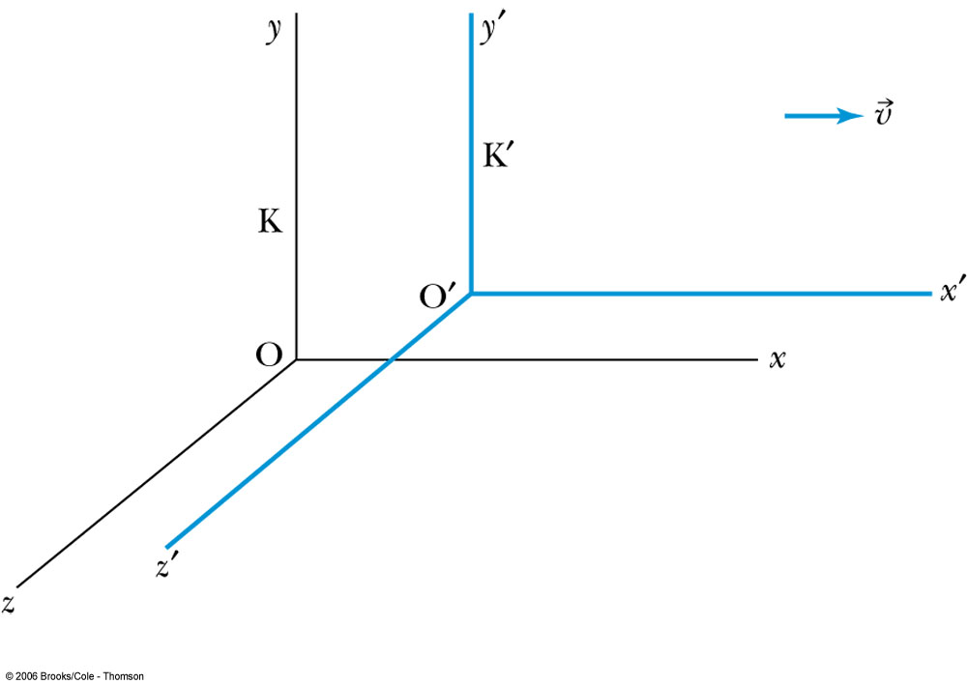
Inertial Frames K and K’
K is at rest and K’ is moving with velocity
Axes are parallel
K and K’ are said to be INERTIAL COORDINATE SYSTEMS

Slide 6

The Galilean Transformation
For a point P
  In system K: P = (x, y, z, t)
  In system K’: P = (x’, y’, z’, t’)
x
P
K
K’
x’-axis
x-axis

Slide 7
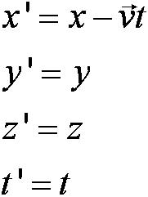
Conditions of the Galilean Transformation
Parallel axes
K’ has a constant relative velocity in the x-direction with respect to K
Time (t) for all observers is a Fundamental invariant, i.e., the same for all inertial observers

Slide 8

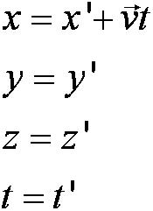
The Inverse Relations
Step 1. Replace with .
Step 2. Replace “primed” quantities with
“unprimed” and “unprimed” with “primed.”

Slide 9
The Transition to Modern Relativity
Although Newton’s laws of motion had the same form under the Galilean transformation, Maxwell’s equations did not.
In 1905, Albert Einstein proposed a fundamental connection between space and time and that Newton’s laws are only an approximation.

Slide 10
2.1: The Need for Ether
The wave nature of light suggested that there existed a propagation medium called the luminiferous ether or just ether.
  Ether had to have such a low density that the planets could move through it without loss of energy
  It also had to have an elasticity to support the high velocity of light waves

Slide 11

Maxwell’s Equations
In Maxwell’s theory the speed of light, in terms of the permeability and permittivity of free space, was given by
Thus the velocity of light between moving systems must be a constant.

Slide 12
An Absolute Reference System
Ether was proposed as an absolute reference system in which the speed of light was this constant and from which other measurements could be made.
The Michelson-Morley experiment was an attempt to show the existence of ether.

Slide 13
2.2: The Michelson-Morley Experiment
Albert Michelson (1852–1931) was the first U.S. citizen to receive the Nobel Prize for Physics (1907), and built an extremely precise device called an interferometer to measure the minute phase difference between two light waves traveling in mutually orthogonal directions.

Slide 14
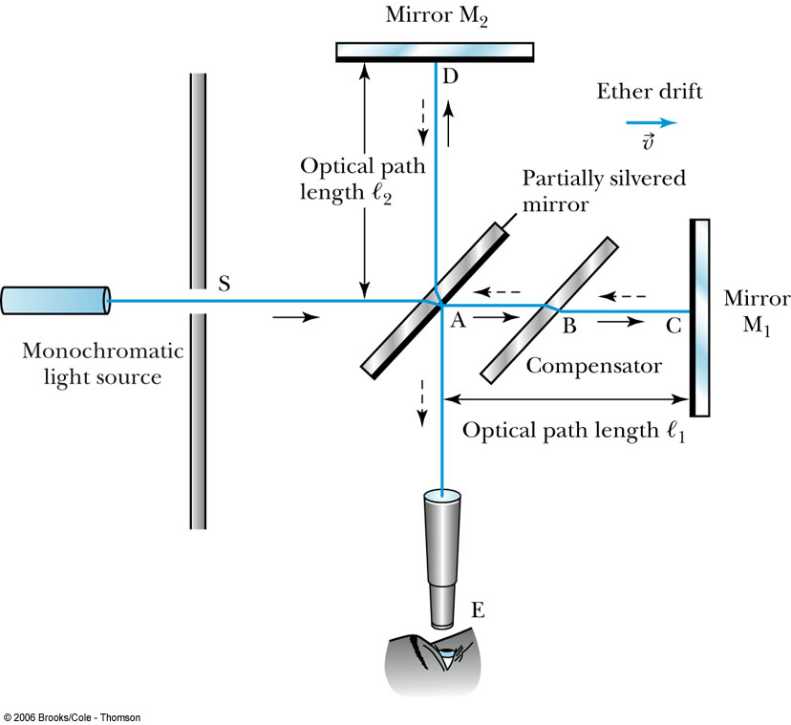
The Michelson Interferometer

Slide 15
1. AC is parallel to the motion of the Earth inducing an “ether wind”
2. Light from source S is split by mirror A and travels to mirrors C and D in mutually perpendicular directions
3. After reflection the beams recombine at A slightly out of phase due to the “ether wind” as viewed by telescope E.
0
The Michelson Interferometer

Slide 16
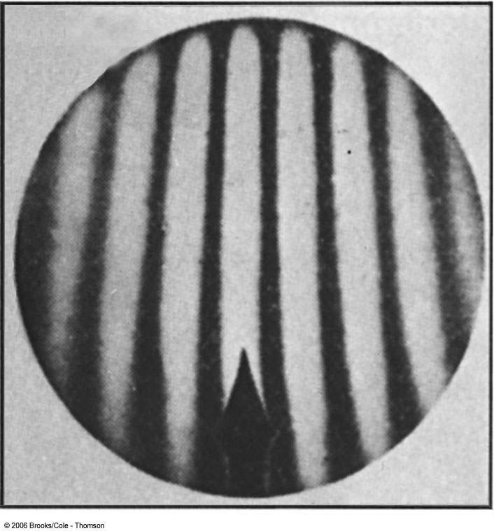
Typical interferometer fringe pattern expected when the system is rotated by 90°

Slide 17
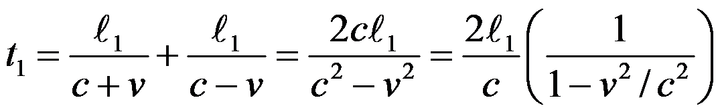
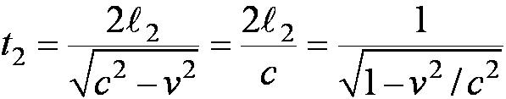
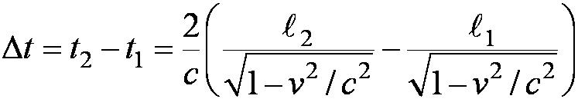
The Analysis
Assuming the Galilean Transformation
Time t₁ from A to C and back:
Time t₂ from A to D and back:
So that the change in time is:

Slide 18

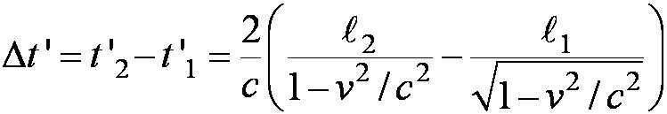
The Analysis (continued)
Upon rotating the apparatus, the optical path lengths ℓ₁ and ℓ₂ are interchanged producing a different change in time: (note the change in denominators)

Slide 19
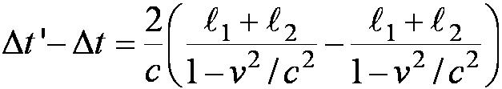

The Analysis (continued)
Thus a time difference between rotations is given by:
and upon a binomial expansion, assuming
v/c << 1, this reduces to

Slide 20
Results
Using the Earth’s orbital speed as:
V = 3 × 10⁴ m/s
together with
ℓ₁ ≈ ℓ₂ = 1.2 m
So that the time difference becomes
Δt’ − Δt ≈ v²(ℓ₁ + ℓ₂)/c³ = 8 × 10⁻¹⁷ s
Although a very small number, it was within the experimental range of measurement for light waves.

Slide 21
Michelson’s Conclusion
Michelson noted that he should be able to detect a phase shift of light due to the time difference between path lengths but found none.
He thus concluded that the hypothesis of the stationary ether must be incorrect.
After several repeats and refinements with assistance from Edward Morley (1893-1923), again a null result.
Thus, ether does not seem to exist!

Slide 22
Possible Explanations
Many explanations were proposed but the most popular was the ether drag hypothesis.
  This hypothesis suggested that the Earth somehow “dragged” the ether along as it rotates on its axis and revolves about the sun.
  This was contradicted by stellar abberation wherein telescopes had to be tilted to observe starlight due to the Earth’s motion. If ether was dragged along, this tilting would not exist.

Slide 23
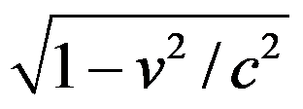
The Lorentz-FitzGerald Contraction
Another hypothesis proposed independently by both H. A. Lorentz and G. F. FitzGerald suggested that the length ℓ₁, in the direction of the motion was contracted by a factor of
…thus making the path lengths equal to account for the zero phase shift.
  This, however, was an ad hoc assumption that could not be experimentally tested.

Slide 24
2.3: Einstein’s Postulates
Albert Einstein (1879–1955) was only two years old when Michelson reported his first null measurement for the existence of the ether.
At the age of 16 Einstein began thinking about the form of Maxwell’s equations in moving inertial systems.
In 1905, at the age of 26, he published his startling proposal about the principle of relativity, which he believed to be fundamental.

Slide 25
Einstein’s Two Postulates
With the belief that Maxwell’s equations must be
valid in all inertial frames, Einstein proposes the
following postulates:
The principle of relativity: The laws of physics are the same in all inertial systems. There is no way to detect absolute motion, and no preferred inertial system exists.
The constancy of the speed of light: Observers in all inertial systems measure the same value for the speed of light in a vacuum.

Slide 26
Re-evaluation of Time
In Newtonian physics we previously assumed that t = t’
  Thus with “synchronized” clocks, events in K and K’ can be considered simultaneous
Einstein realized that each system must have its own observers with their own clocks and meter sticks
  Thus events considered simultaneous in K may not be in K’

Slide 27



The Problem of Simultaneity
Frank at rest is equidistant from events A and B:
A B
−1 m +1 m
0
Frank “sees” both flashbulbs go off simultaneously.

Slide 28

The Problem of Simultaneity
Mary, moving to the right with speed v, observes events A and B in different order:
−1 m 0 +1 m
A B
Mary “sees” event B, then A.

Slide 29
We thus observe…
Two events that are simultaneous in one reference frame (K) are not necessarily simultaneous in another reference frame (K’) moving with respect to the first frame.
This suggests that each coordinate system has its own observers with “clocks” that are synchronized…

Slide 30
Synchronization of Clocks
Step 1: Place observers with clocks throughout a given system.
Step 2: In that system bring all the clocks together at one location.
Step 3: Compare the clock readings.
If all of the clocks agree, then the clocks are said to be synchronized.

Slide 31
A method to synchronize…
One way is to have one clock at the origin set to t = 0 and advance each clock by a time (d/c) with d being the distance of the clock from the origin.
  Allow each of these clocks to begin timing when a light signal arrives from the origin.
t = 0
t = d/c t = d/c
d d

Slide 32
The Lorentz Transformations
The special set of linear transformations that:
preserve the constancy of the speed of light (c) between inertial observers;
and,
account for the problem of simultaneity between these observers
known as the Lorentz transformation equations

Slide 33
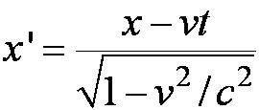


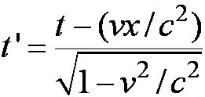
Lorentz Transformation Equations

Slide 34

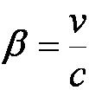

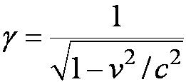


Lorentz Transformation Equations
A more symmetric form:

Slide 35

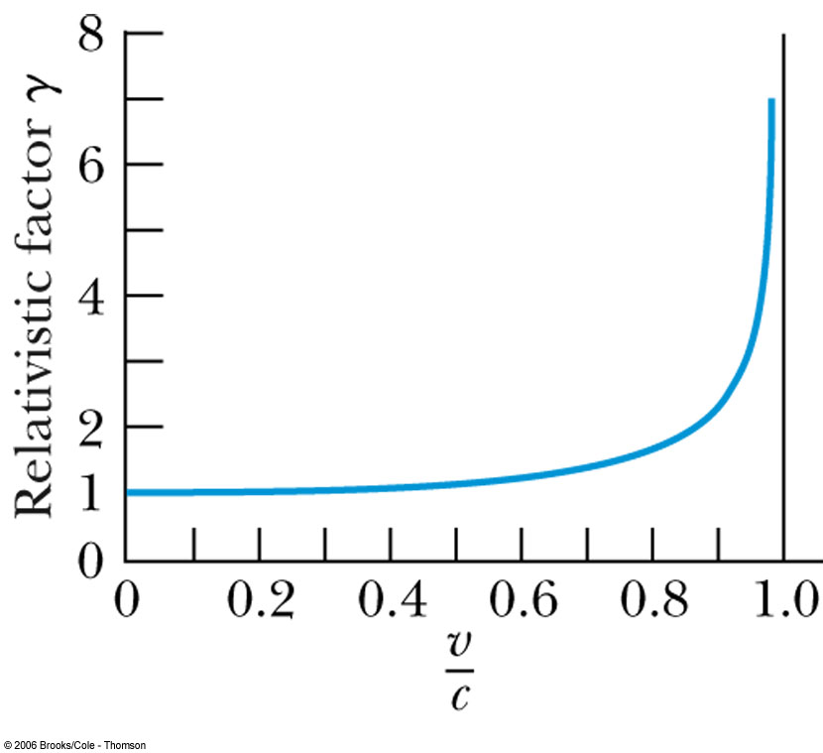
Properties of γ
Recall β = v/c < 1 for all observers.
equals 1 only when v = 0.
Graph of β:
(note v ≠ c)

Slide 36
Derivation
Use the fixed system K and the moving system K’
At t = 0 the origins and axes of both systems are coincident with system K’ moving to the right along the x axis.
A flashbulb goes off at the origins when t = 0.
According to postulate 2, the speed of light will be c in both systems and the wavefronts observed in both systems must be spherical.
K K’

Slide 37


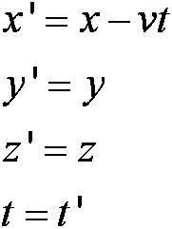
Derivation
Spherical wavefronts in K:
Spherical wavefronts in K’:
Note: these are not preserved in the classical transformations with

Slide 38


Derivation
Let x’ = (x – vt) so that x = (x’ + vt’)
By Einstein’s first postulate:
The wavefront along the x,x’- axis must satisfy:
x = ct and x’ = ct’
Thus ct’ = (ct – vt) and ct = (ct’ + vt’)
Solving the first one above for t’ and substituting into the second...

Slide 39
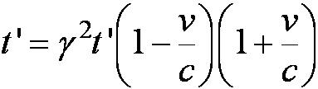
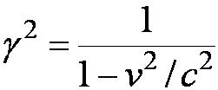
Derivation
Gives the following result:
from which we derive:

Slide 40
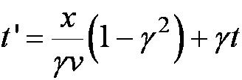
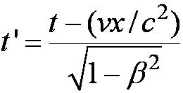
Finding a Transformation for t’
Recalling x’ = (x – vt) substitute into x = (x’ + vt) and solving for t ’ we obtain:
which may be written in terms of β (= v/c):

Slide 41
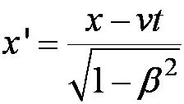
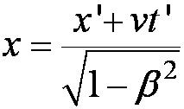


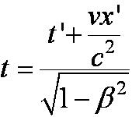
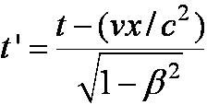
Thus the complete Lorentz Transformation

Slide 42
Remarks
If v << c, i.e., β ≈ 0 and ≈ 1, we see these equations reduce to the familiar Galilean transformation.
Space and time are now not separated.
For non-imaginary transformations, the frame velocity cannot exceed c.

Slide 43
2.5: Time Dilation and Length Contraction
Consequences of the Lorentz Transformation:
Time Dilation:
Clocks in K’ run slow with respect to stationary clocks in K.
Length Contraction:
Lengths in K’ are contracted with respect to the same lengths stationary in K.

Slide 44
Time Dilation
To understand time dilation the idea of proper time must be understood:
The term proper time,T₀, is the time difference between two events occurring at the same position in a system as measured by a clock at that position.
Same location

Slide 45
Time Dilation
Not Proper Time
Beginning and ending of the event occur at different positions

Slide 46
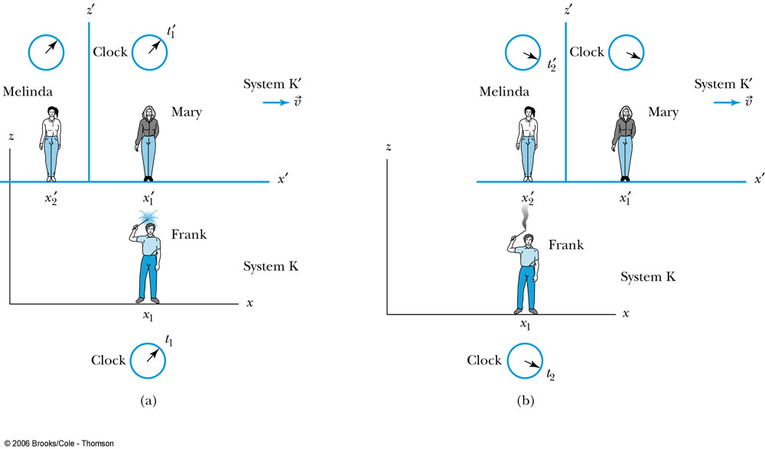
Time Dilation
Frank’s clock is at the same position in system K when the sparkler is lit in (a) and when it goes out in (b). Mary, in the moving system K’, is beside the sparkler at (a). Melinda then moves into the position where and when the sparkler extinguishes at (b). Thus, Melinda, at the new position, measures the time in system K’ when the sparkler goes out in (b).

Slide 47
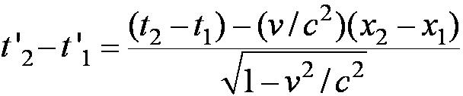
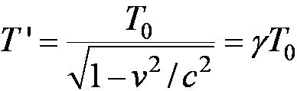
According to Mary and Melinda…
Mary and Melinda measure the two times for the sparkler to be lit and to go out in system K’ as times t’₁ and t’₂ so that by the Lorentz transformation:
  Note here that Frank records x – x₁ = 0 in K with a proper time: T₀ = t₂ – t₁ or
with T ’ = t’₂ - t’₁

Slide 48
Time Dilation
1) T ’ > T₀ or the time measured between two events at different positions is greater than the time between the same events at one position: time dilation.
2) The events do not occur at the same space and time coordinates in the two system
3) System K requires 1 clock and K’ requires 2 clocks.

Slide 49
Length Contraction
To understand length contraction the idea of proper length must be understood:
Let an observer in each system K and K’ have a meter stick at rest in their own system such that each measure the same length at rest.
The length as measured at rest is called the proper length.

Slide 50
What Frank and Mary see…
Each observer lays the stick down along his or her respective x axis, putting the left end at x_{ℓ} (or x’_{ℓ}) and the right end at x_{r} (or x’_{r}).
  Thus, in system K, Frank measures his stick to be:
L₀ = x_{r} - x_{ℓ}
  Similarly, in system K’, Mary measures her stick at rest to be:
L’₀ = x’_{r} – x’_{ℓ}

Slide 51
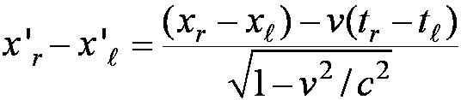
What Frank and Mary measure
Frank in his rest frame measures the moving length in Mary’s frame moving with velocity.
Thus using the Lorentz transformations Frank measures the length of the stick in K’ as:
Where both ends of the stick must be measured simultaneously, i.e, t_{r} = t_{ℓ}
Here Mary’s proper length is L’₀ = x’_{r} – x’_{ℓ}
and Frank’s measured length is L = x_{r} – x_{ℓ}

Slide 52
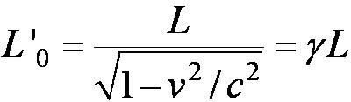
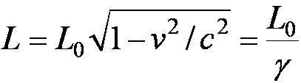
Frank’s measurement
So Frank measures the moving length as L given by
but since both Mary and Frank in their respective frames measure L’₀ = L₀
and L₀ > L, i.e. the moving stick shrinks.

Slide 53
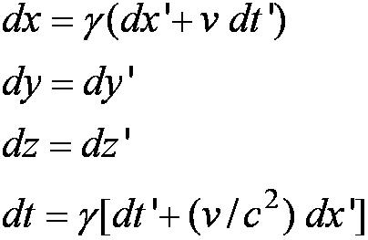
2.6: Addition of Velocities
Taking differentials of the Lorentz transformation, relative velocities may be calculated:

Slide 54
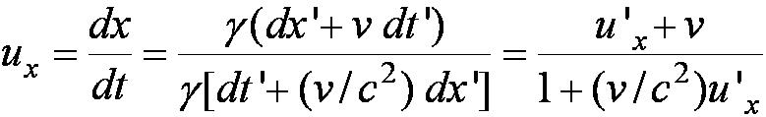
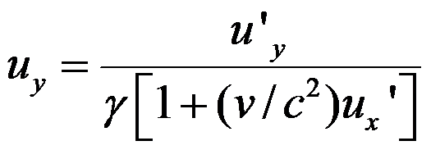
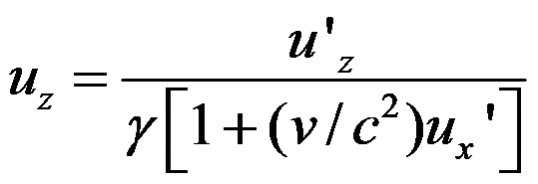
So that…
defining velocities as: u_{x} = dx/dt, u_{y} = dy/dt,
u’_{x} = dx’/dt’, etc. it is easily shown that:
With similar relations for u_{y} and u_{z:}

Slide 55
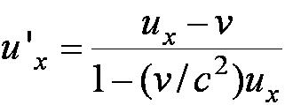
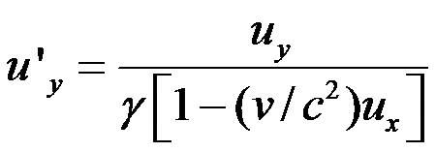
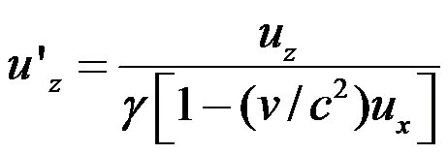
The Lorentz Velocity Transformations
In addition to the previous relations, the Lorentz velocity transformations for u’_{x}, u’_{y} , and u’_{z} can be obtained by switching primed and unprimed and changing v to –v:

Slide 56
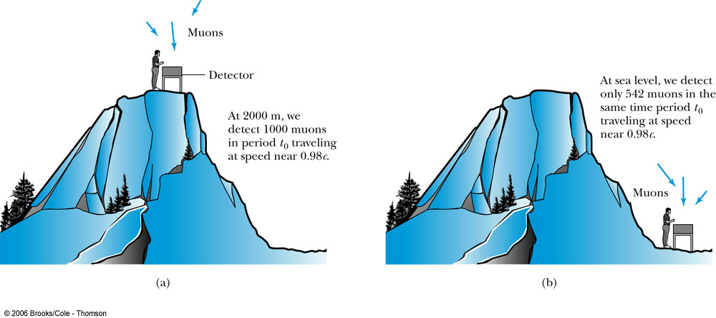
2.7: Experimental Verification
Time Dilation and Muon Decay
Figure 2.18: The number of muons detected with speeds near 0.98c is much different (a) on top of a mountain than (b) at sea level, because of the muon’s decay. The experimental result agrees with our time dilation equation.

Slide 57
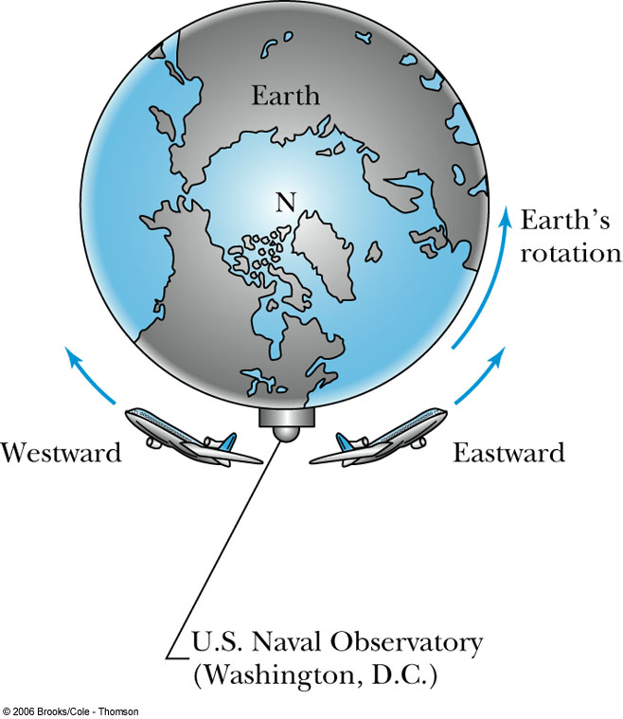
Atomic Clock Measurement
Figure 2.20: Two airplanes took off (at different times) from Washington, D.C., where the U.S. Naval Observatory is located. The airplanes traveled east and west around Earth as it rotated. Atomic clocks on the airplanes were compared with similar clocks kept at the observatory to show that the moving clocks in the airplanes ran slower.

Slide 58
2.8: Twin Paradox
The Set-up
Twins Mary and Frank at age 30 decide on two career paths: Mary decides to become an astronaut and to leave on a trip 8 lightyears (ly) from the Earth at a great speed and to return; Frank decides to reside on the Earth.
The Problem
Upon Mary’s return, Frank reasons that her clocks measuring her age must run slow. As such, she will return younger. However, Mary claims that it is Frank who is moving and consequently his clocks must run slow.
The Paradox
Who is younger upon Mary’s return?

Slide 59
The Resolution
Frank’s clock is in an inertial system during the entire trip; however, Mary’s clock is not. As long as Mary is traveling at constant speed away from Frank, both of them can argue that the other twin is aging less rapidly.
When Mary slows down to turn around, she leaves her original inertial system and eventually returns in a completely different inertial system.
Mary’s claim is no longer valid, because she does not remain in the same inertial system. There is also no doubt as to who is in the inertial system. Frank feels no acceleration during Mary’s entire trip, but Mary does.

Slide 60
2.9: Spacetime
When describing events in relativity, it is convenient to represent events on a spacetime diagram.
In this diagram one spatial coordinate x, to specify position, is used and instead of time t, ct is used as the other coordinate so that both coordinates will have dimensions of length.
Spacetime diagrams were first used by H. Minkowski in 1908 and are often called Minkowski diagrams. Paths in Minkowski spacetime are called worldlines.

Slide 61
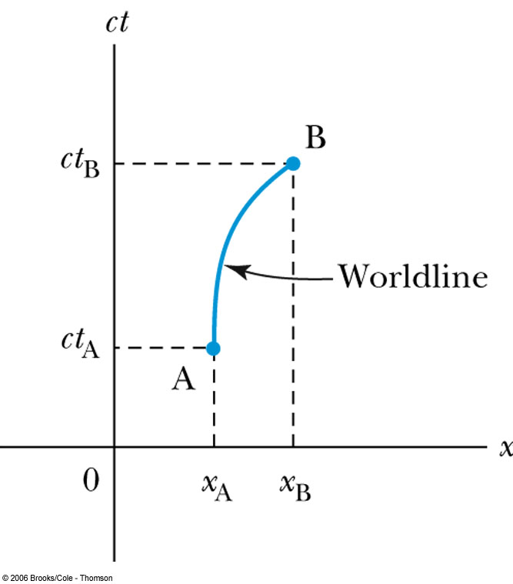
Spacetime Diagram

Slide 62
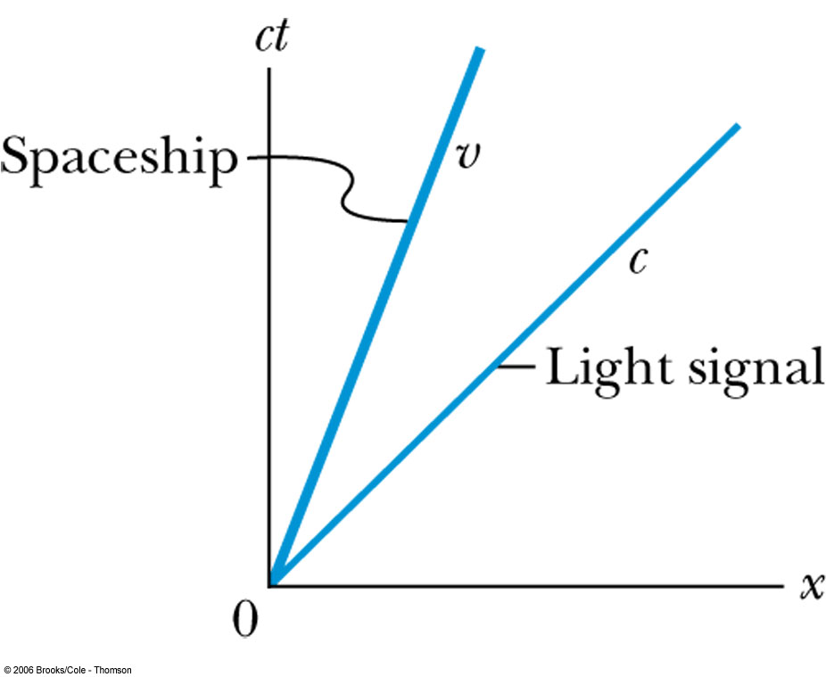
Particular Worldlines

Slide 63
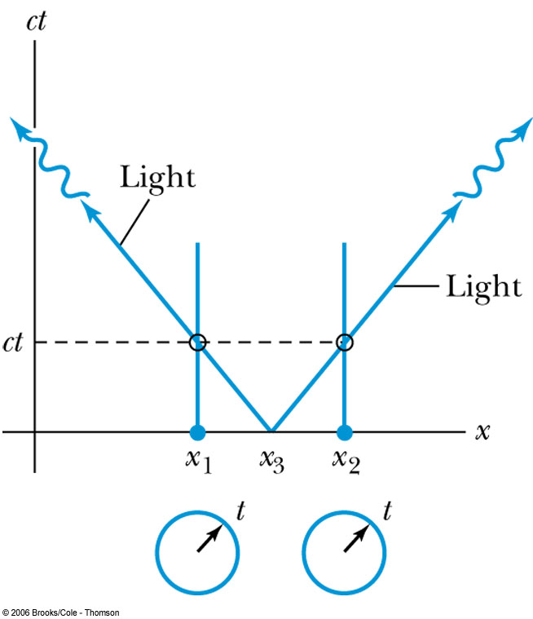
Worldlines and Time

Slide 64
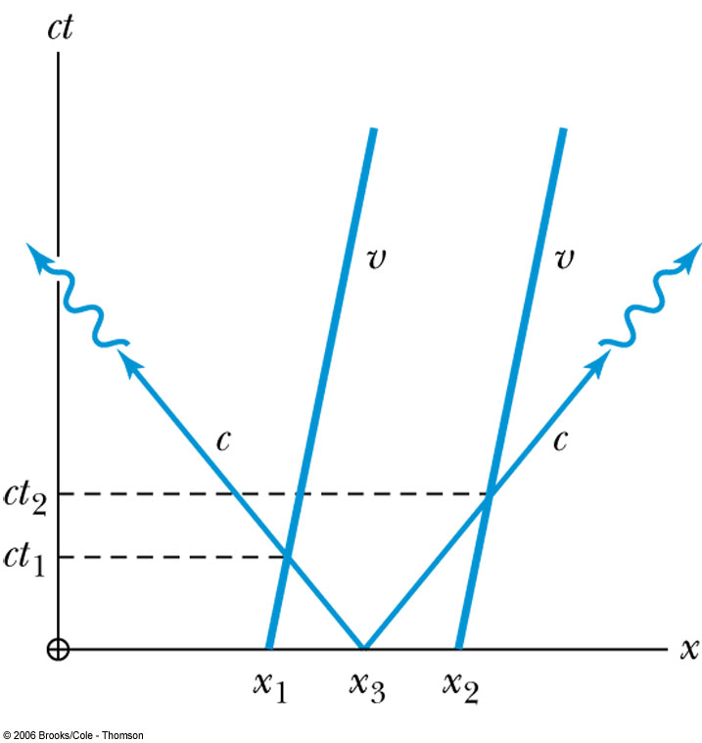
Moving Clocks

Slide 65
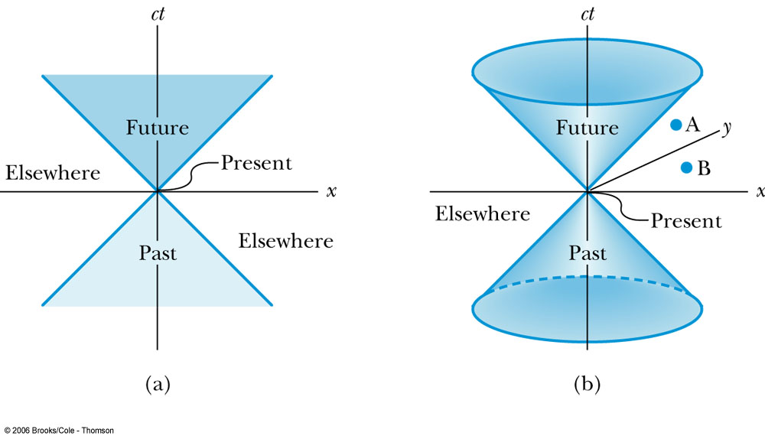
The Light Cone

Slide 66
Spacetime Interval
Since all observers “see” the same speed of
light, then all observers, regardless of their
velocities, must see spherical wave fronts.
s² = x² – c²t² = (x’)² – c² (t’)² = (s’)²

Slide 67
Spacetime Invariants
If we consider two events, we can determine the quantity Δs² between the two events, and we find that it is invariant in any inertial frame. The quantity Δs is known as the spacetime interval between two events.

Slide 68
Spacetime Invariants
There are three possibilities for the invariant quantity Δs²:
Δs² = 0: Δx² = c² Δt², and the two events can be connected only by a light signal. The events are said to have a lightlike separation.
Δs² > 0: Δx² > c² Δt², and no signal can travel fast enough to connect the two events. The events are not causally connected and are said to have a spacelike separation.
Δs² < 0: Δx² < c² Δt², and the two events can be causally connected. The interval is said to be timelike.

Slide 69
2.10: The Doppler Effect
The Doppler effect of sound in introductory physics is represented by an increased frequency of sound as a source such as a train (with whistle blowing) approaches a receiver (our eardrum) and a decreased frequency as the source recedes.
Also, the same change in sound frequency occurs when the source is fixed and the receiver is moving. The change in frequency of the sound wave depends on whether the source or receiver is moving.
On first thought it seems that the Doppler effect in sound violates the principle of relativity, until we realize that there is in fact a special frame for sound waves. Sound waves depend on media such as air, water, or a steel plate in order to propagate; however, light does not!

Slide 70
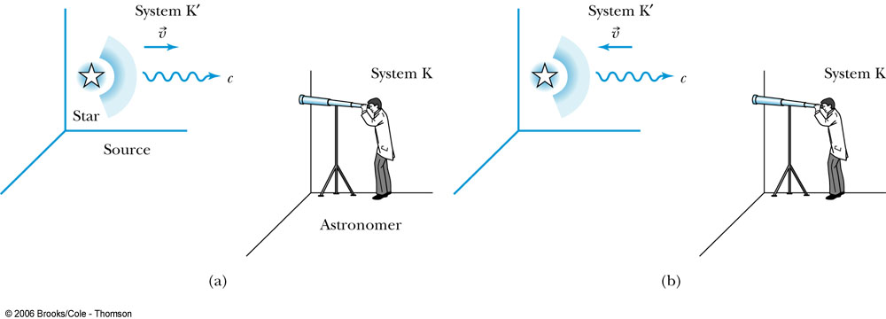
Recall the Doppler Effect

Slide 71
The Relativistic Doppler Effect
Consider a source of light (for example, a star) and a receiver
(an astronomer) approaching one another with a relative velocity v.
Consider the receiver in system K and the light source in system K’ moving toward the receiver with velocity v.
The source emits n waves during the time interval T.
Because the speed of light is always c and the source is moving with velocity v, the total distance between the front and rear of the wave transmitted during the time interval T is:
Length of wave train = cT − vT

Slide 72
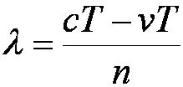
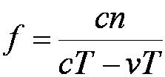
The Relativistic Doppler Effect
Because there are n waves, the wavelength is given by
And the resulting frequency is

Slide 73
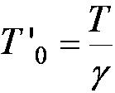
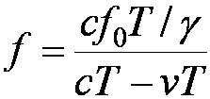

The Relativistic Doppler Effect
In this frame: f₀ = n / T ’₀ and
Thus:

Slide 74

Source and Receiver Approaching
With β = v / c the resulting frequency is given by:
(source and receiver approaching)

Slide 75

Source and Receiver Receding
In a similar manner, it is found that:
(source and receiver receding)

Slide 76

The Relativistic Doppler Effect
Equations (2.32) and (2.33) can be combined into one equation if we agree to use a + sign for β (+v/c) when the source and receiver are approaching each other and a – sign for β (– v/c) when they are receding. The final equation becomes
Relativistic Doppler effect (2.34)

Slide 77
2.11: Relativistic Momentum
Because physicists believe that the conservation of momentum is fundamental, we begin by considering collisions where there do not exist external forces and
dP/dt = F_{ext} = 0

Slide 78

Relativistic Momentum
Frank (fixed or stationary system) is at rest in system K holding a ball of mass m. Mary (moving system) holds a similar ball in system K that is moving in the x direction with velocity v with respect to system K.

Slide 79
Relativistic Momentum
If we use the definition of momentum, the momentum of the ball thrown by Frank is entirely in the y direction:
p_{Fy} = mu₀
The change of momentum as observed by Frank is
Δp_{F} = Δp_{Fy} = −2mu₀

Slide 80


According to Mary
Mary measures the initial velocity of her own ball to be u’_{Mx} = 0 and u’_{My} = −u₀.
In order to determine the velocity of Mary’s ball as measured by Frank we use the velocity transformation equations:

Slide 81




Relativistic Momentum
Before the collision, the momentum of Mary’s ball as measured by Frank becomes
Before
Before
For a perfectly elastic collision, the momentum after the collision is
After
After
The change in momentum of Mary’s ball according to Frank is
(2.42)
(2.43)
(2.44)

Slide 82
Relativistic Momentum
The conservation of linear momentum requires the total change in momentum of the collision, Δp_{F} + Δp_{M}, to be zero. The addition of Equations (2.40) and (2.44) clearly does not give zero.
Linear momentum is not conserved if we use the conventions for momentum from classical physics even if we use the velocity transformation equations from the special theory of relativity.
There is no problem with the x direction, but there is a problem with the y direction along the direction the ball is thrown in each system.

Slide 83



Relativistic Momentum
Rather than abandon the conservation of linear momentum, let us look for a modification of the definition of linear momentum that preserves both it and Newton’s second law.
To do so requires reexamining mass to conclude that:
Relativistic momentum (2.48)

Slide 84
Relativistic Momentum
Some physicists like to refer to the mass in Equation (2.48) as the rest mass m₀ and call the term m = γm₀ the relativistic mass. In this manner the classical form of momentum, m, is retained. The mass is then imagined to increase at high speeds.
Most physicists prefer to keep the concept of mass as an invariant, intrinsic property of an object. We adopt this latter approach and will use the term mass exclusively to mean rest mass. Although we may use the terms mass and rest mass synonymously, we will not use the term relativistic mass. The use of relativistic mass to often leads the student into mistakenly inserting the term into classical expressions where it does not apply.

Slide 85

2.12: Relativistic Energy
Due to the new idea of relativistic mass, we must now redefine the concepts of work and energy.
  Therefore, we modify Newton’s second law to include our new definition of linear momentum, and force becomes:

Slide 86


Relativistic Energy
The work W₁₂ done by a force to move a particle from position 1 to position 2 along a path is defined to be
where K₁ is defined to be the kinetic energy of the particle at position 1.
(2.55)

Slide 87

Relativistic Energy
For simplicity, let the particle start from rest under the influence of the force and calculate the kinetic energy K after the work is done.

Slide 88




Relativistic Kinetic Energy
The limits of integration are from an initial value of 0 to a final value of .
The integral in Equation (2.57) is straightforward if done by the method of integration by parts. The result, called the relativistic kinetic energy, is
(2.57)
(2.58)

Slide 89


Relativistic Kinetic Energy
Equation (2.58) does not seem to resemble the classical result for kinetic energy, K = ½mu². However, if it is correct, we expect it to reduce to the classical result for low speeds. Let’s see if it does. For speeds u << c, we expand in a binomial series as follows:
where we have neglected all terms of power (u/c)⁴ and greater, because u << c. This gives the following equation for the relativistic kinetic energy at low speeds:
which is the expected classical result. We show both the relativistic and classical kinetic energies in Figure 2.31. They diverge considerably above a velocity of 0.6c.
(2.59)

Slide 90

Relativistic and Classical Kinetic Energies

Slide 91



Total Energy and Rest Energy
We rewrite Equation (2.58) in the form
The term mc² is called the rest energy and is denoted by E₀.
This leaves the sum of the kinetic energy and rest energy to be interpreted as the total energy of the particle. The total energy is denoted by E and is given by
(2.63)
(2.64)
(2.65)

Slide 92





Momentum and Energy
We square this result, multiply by c², and rearrange the result.
We use Equation (2.62) for β² and find

Slide 93



Momentum and Energy (continued)
The first term on the right-hand side is just E², and the second term is E₀². The last equation becomes
We rearrange this last equation to find the result we are seeking, a relation between energy and momentum.
or
Equation (2.70) is a useful result to relate the total energy of a particle with its momentum. The quantities (E² – p²c²) and m are invariant quantities. Note that when a particle’s velocity is zero and it has no momentum, Equation (2.70) correctly gives E₀ as the particle’s total energy.
(2.70)
(2.71)

Slide 94
2.13: Computations in Modern Physics
We were taught in introductory physics that the international system of units is preferable when doing calculations in science and engineering.
In modern physics a somewhat different, more convenient set of units is often used.
The smallness of quantities often used in modern physics suggests some practical changes.

Slide 95
Units of Work and Energy
Recall that the work done in accelerating a charge through a potential difference is given by W = qV.
For a proton, with the charge e = 1.602 × 10⁻¹⁹ C being accelerated across a potential difference of 1 V, the work done is
W = (1.602 × 10⁻¹⁹)(1 V) = 1.602 × 10⁻¹⁹ J

Slide 96
The Electron Volt (eV)
The work done to accelerate the proton across a potential difference of 1 V could also be written as
W = (1 e)(1 V) = 1 eV
Thus eV, pronounced “electron volt,” is also a unit of energy. It is related to the SI (Système International) unit joule by the 2 previous equations.
1 eV = 1.602 × 10⁻¹⁹ J

Slide 97




Other Units
Rest energy of a particle:
Example: E₀ (proton)
Atomic mass unit (amu):
Example: carbon-12
Mass (¹²C atom)
Mass (¹²C atom)

Slide 98
Binding Energy
The equivalence of mass and energy becomes apparent when we study the binding energy of systems like atoms and nuclei that are formed from individual particles.
The potential energy associated with the force keeping the system together is called the binding energy E_{B}.

Slide 99


Binding Energy
The binding energy is the difference between the rest energy of the individual particles and the rest energy of the combined bound system.

Slide 100
Electromagnetism and Relativity
Einstein was convinced that magnetic fields appeared as electric fields observed in another inertial frame. That conclusion is the key to electromagnetism and relativity.
Einstein’s belief that Maxwell’s equations describe electromagnetism in any inertial frame was the key that led Einstein to the Lorentz transformations.
Maxwell’s assertion that all electromagnetic waves travel at the speed of light and Einstein’s postulate that the speed of light is invariant in all inertial frames seem intimately connected.

Slide 101

A Conducting Wire
0

Slide 102
CHAPTER 15
General Relativity
15.1 Tenets of General Relativity
15.2 Tests of General Relativity
15.3 Gravitational Waves
15.4 Black Holes
15.5 Frame Dragging
There is nothing in the world except empty, curved space. Matter, charge, electromagnetism, and other fields are only manifestations of the curvature.
- John Archibald Wheeler

Slide 103
15.1: Tenets of General Relativity
General relativity is the extension of special relativity. It includes the effects of accelerating objects and their mass on spacetime.
As a result, the theory is an explanation of gravity.
It is based on two concepts: (1) the principle of equivalence, which is an extension of Einstein’s first postulate of special relativity and (2) the curvature of spacetime due to gravity.

Slide 104

Principle of Equivalence
The principle of equivalence is an experiment in noninertial reference frames.
Consider an astronaut sitting in a confined space on a rocket placed on Earth. The astronaut is strapped into a chair that is mounted on a weighing scale that indicates a mass M. The astronaut drops a safety manual that falls to the floor.
Now contrast this situation with the rocket accelerating through space. The gravitational force of the Earth is now negligible. If the acceleration has exactly the same magnitude g on Earth, then the weighing scale indicates the same mass M that it did on Earth, and the safety manual still falls with the same acceleration as measured by the astronaut. The question is: How can the astronaut tell whether the rocket is on earth or in space?
Principle of equivalence: There is no experiment that can be done in a small confined space that can detect the difference between a uniform gravitational field and an equivalent uniform acceleration.

Slide 105



Inertial Mass and Gravitational Mass
Recall from Newton’s 2nd law that an object accelerates in reaction to a force according to its inertial mass:
Inertial mass measures how strongly an object resists a change in its motion.
Gravitational mass measures how strongly it attracts other objects.
For the same force, we get a ratio of masses:
According to the principle of equivalence, the inertial and gravitational masses are equal.

Slide 106

Light Deflection
Consider accelerating through a region of space where the gravitational force is negligible. A small window on the rocket allows a beam of starlight to enter the spacecraft. Since the velocity of light is finite, there is a nonzero amount of time for the light to shine across the opposite wall of the spaceship.
During this time, the rocket has accelerated upward. From the point of view of a passenger in the rocket, the light path appears to bend down toward the floor.
The principle of equivalence implies that an observer on Earth watching light pass through the window of a classroom will agree that the light bends toward the ground.
This prediction seems surprising, however the unification of mass and energy from the special theory of relativity hints that the gravitational force of the Earth could act on the effective mass of the light beam.

Slide 107


Spacetime Curvature of Space
Light bending for the Earth observer seems to violate the premise that the velocity of light is constant from special relativity. Light traveling at a constant velocity implies that it travels in a straight line.
Einstein recognized that we need to expand our definition of a straight line.
The shortest distance between two points on a flat surface appears different than the same distance between points on a sphere. The path on the sphere appears curved. We shall expand our definition of a straight line to include any minimized distance between two points.
Thus if the spacetime near the Earth is not flat, then the straight line path of light near the Earth will appear curved.

Slide 108
The Unification of Mass and Spacetime
Einstein mandated that the mass of the Earth creates a dimple on the spacetime surface. In other words, the mass changes the geometry of the spacetime.
The geometry of the spacetime then tells matter how to move.
Einstein’s famous field equations sum up this relationship as:
* mass-energy tells spacetime how to curve
* Spacetime curvature tells matter how to move
The result is that a standard unit of length such as a meter stick increases in the vicinity of a mass.

Slide 109

15.2: Tests of General Relativity
Bending of Light
During a solar eclipse of the sun by the moon, most of the sun’s light is blocked on Earth, which afforded the opportunity to view starlight passing close to the sun in 1919. The starlight was bent as it passed near the sun which caused the star to appear displaced.
Einstein’s general theory predicted a deflection of 1.75 seconds of arc, and the two measurements found 1.98 ± 0.16 and 1.61 ± 0.40 seconds.
Since the eclipse of 1919, many experiments, using both starlight and radio waves from quasars, have confirmed Einstein’s predictions about the bending of light with increasingly good accuracy.

Slide 110

Gravitational Lensing
When light from a distant object like a quasar passes by a nearby galaxy on its way to us on Earth, the light can be bent multiple times as it passes in different directions around the galaxy.

Slide 111
Gravitational Redshift
The second test of general relativity is the predicted frequency change of light near a massive object.
Imagine a light pulse being emitted from the surface of the Earth to travel vertically upward. The gravitational attraction of the Earth cannot slow down light, but it can do work on the light pulse to lower its energy. This is similar to a rock being thrown straight up. As it goes up, its gravitational potential energy increases while its kinetic energy decreases. A similar thing happens to a light pulse.
A light pulse’s energy depends on its frequency f through Planck’s constant, E = hf. As the light pulse travels up vertically, it loses kinetic energy and its frequency decreases. Its wavelength increases, so the wavelengths of visible light are shifted toward the red end of the visible spectrum.
This phenomenon is called gravitational redshift.

Slide 112



Gravitational Redshift Experiments
An experiment conducted in a tall tower measured the “blueshift” change in frequency of a light pulse sent down the tower. The energy gained when traveling downward a distance H is mgH. If f is the energy frequency of light at the top and f’ is the frequency at the bottom, energy conservation gives hf = hf ’ + mgH.
The effective mass of light is m = E / c² = h f / c².
This yields the ratio of frequency shift to the frequency:
Or in general:
Using gamma rays, the frequency ratio was observed to be:

Slide 113
Gravitational Time Dilation
A very accurate experiment was done by comparing the frequency of an atomic clock flown on a Scout D rocket to an altitude of 10,000 km with the frequency of a similar clock on the ground. The measurement agreed with Einstein’s general relativity theory to within 0.02%.
Since the frequency of the clock decreases near the Earth, a clock in a gravitational field runs more slowly according to the gravitational time dilation.

Slide 114

Perihelion Shift of Mercury
The orbits of the planets are ellipses, and the point closest to the sun in a planetary orbit is called the perihelion. It has been known for hundreds of years that Mercury’s orbit precesses about the sun. Accounting for the perturbations of the other planets left 43 seconds of arc per century that was previously unexplained by classical physics.
The curvature of spacetime explained by general relativity accounted for the 43 seconds of arc shift in the orbit of Mercury.

Slide 115



Light Retardation
As light passes by a massive object, the path taken by the light is longer because of the spacetime curvature.
The longer path causes a time delay for a light pulse traveling close to the sun.
This effect was measured by sending a radar wave to Venus, where it was reflected back to Earth. The position of Venus had to be in the “superior conjunction” position on the other side of the sun from the Earth. The signal passed near the sun and experienced a time delay of about 200 microseconds. This was in excellent agreement with the general theory.

Slide 116
15.3: Gravitational Waves
When a charge accelerates, the electric field surrounding the charge redistributes itself. This change in the electric field produces an electromagnetic wave, which is easily detected. In much the same way, an accelerated mass should also produce gravitational waves.
Gravitational waves carry energy and momentum, travel at the speed of light, and are characterized by frequency and wavelength.
As gravitational waves pass through spacetime, they cause small ripples. The stretching and shrinking is on the order of 1 part in 10²¹ even due to a strong gravitational wave source.
Due to their small magnitude, gravitational waves would be difficult to detect. Large astronomical events could create measurable spacetime waves such as the collapse of a neutron star, a black hole or the Big Bang.
This effect has been likened to noticing a single grain of sand added to all the beaches of Long Island, New York.

Slide 117

Gravitational Wave Experiments
Taylor and Hulse discovered a binary system of two neutron stars that lose energy due to gravitational waves that agrees with the predictions of general relativity.
LIGO is a large Michelson interferometer device that uses four test masses on two arms of the interferometer. The device will detect changes in length of the arms due to a passing wave.
NASA and the European Space Agency (ESA) are jointly developing a space-based probe called the Laser Interferometer Space Antenna (LISA) which will measure fluctuations in its triangular shape.

Slide 118


15.4: Black Holes
While a star is burning, the heat produced by the thermonuclear reactions pushes out the star’s matter and balances the force of gravity. When the star’s fuel is depleted, no heat is left to counteract the force of gravity, which becomes dominant. The star’s mass collapses into an incredibly dense ball that could wrap spacetime enough to not allow light to escape. The point at the center is called a singularity.
A collapsing star greater than 3 solar masses will distort spacetime in this way to create a black hole.
Karl Schwarzschild determined the radius of a black hole known as the event horizon.

Slide 119


Black Hole Detection
Since light can’t escape, they must be detected indirectly:
Severe redshifting of light.
Hawking radiation results from particle-antiparticle pairs created near the event horizon. One member slips into the singularity as the other escapes. Antiparticles that escape radiate as they combine with matter. Energy expended to pair production at the event horizon decreases the total mass-energy of the black hole.
Hawking calculated the blackbody temperature of the black hole to be:
The power radiated is:
This result is used to detect a black hole by its Hawking radiation.
Mass falling into a black hole would create a rotating accretion disk. Internal friction would create heat and emit x rays.

Slide 120



Black Hole Candidates
Although a black hole has not yet been observed, there are several plausible candidates:
  Cygnus X-1 is an x ray emitter and part of a binary system in the Cygnus constellation. It is roughly 7 solar masses.
  The galactic center of M87 is 3 billion solar masses.
  NGC 4261 is a billion solar masses.

Slide 121
15.5: Frame Dragging
Josef Lense and Hans Thirring proposed in 1918 that a rotating body’s gravitational force can literally drag spacetime around with it as the body rotates. This effect, sometimes called the Lense-Thirring effect, is referred to as frame dragging.
All celestial bodies that rotate can modify the spacetime curvature, and the larger the gravitational force, the greater the effect.
Frame dragging was observed in 1997 by noticing fluctuating x rays from several black hole candidates. This indicated that the object was precessing from the spacetime dragging along with it.
The LAGEOS system of satellites uses Earth-based lasers that reflect off the satellites. Researchers were able to detect that the plane of the satellites shifted 2 meters per year in the direction of the Earth’s rotation in agreement with the predictions of the theory.
Global Positioning Systems (GPS) had to utilize relativistic corrections for the precise atomic clocks on the satellites.

